Slide 1
ŠIAULIŲ R. MEŠKUIČIŲ LOPŠELIS-DARŽELIS
Meškuičiai kindergarten

Slide 2
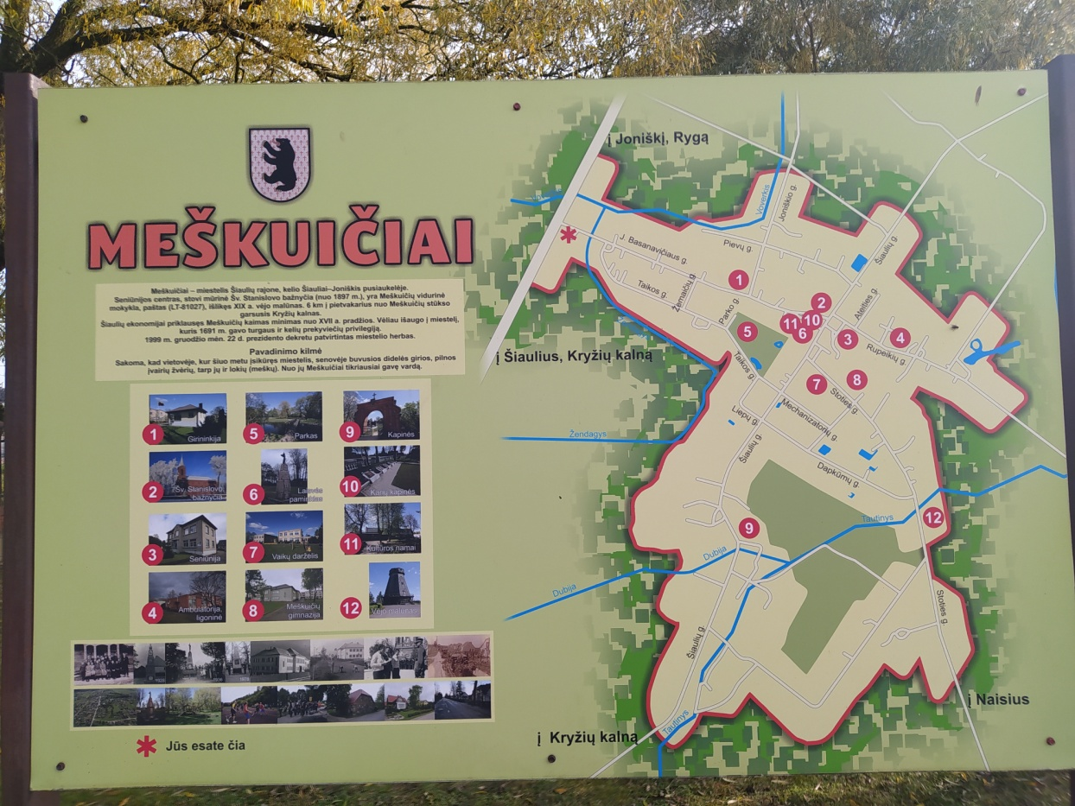
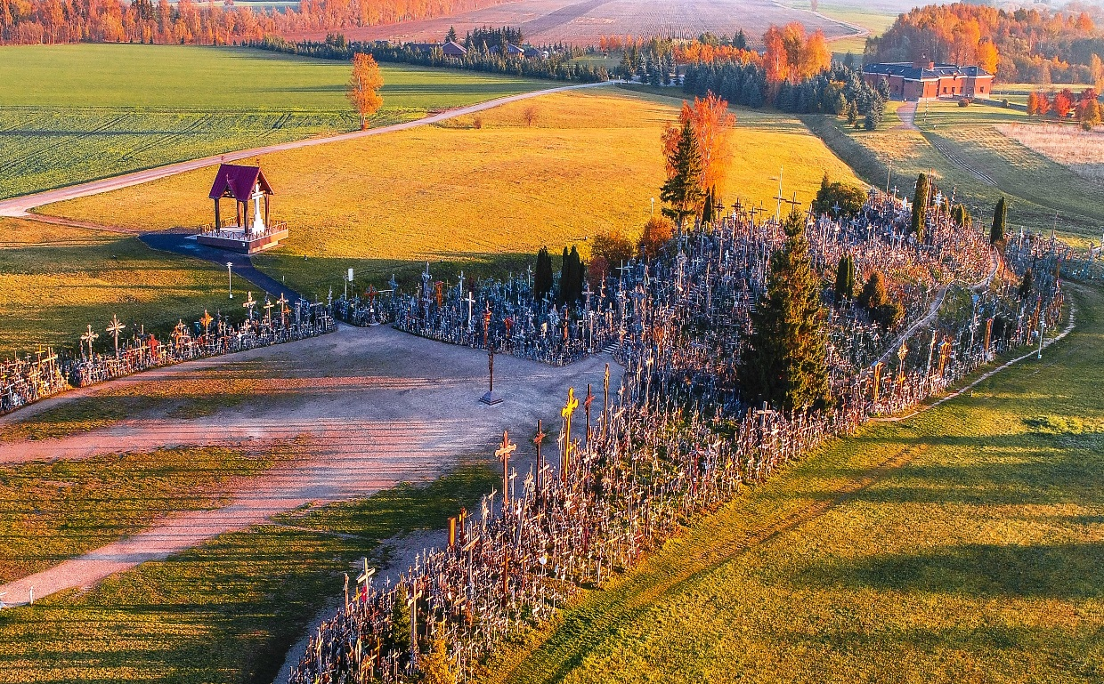
The kindergarten is located in Meškuičiai small town in the north of Lithuania. The famous Hill of Crosses is just 7 km away from kindergarten.

Slide 3
The name of our town means bear. So there are a lot of bears here ☺

Slide 4
Little bears are a symbol of our nursery as well!

Slide 5
Kindergarten is attended by 75 children from 2 to 6/7 years old from Meškuičiai and surrounding villages. There are 4 groups in the kindergarten. They all have their names:
Nursery group "Kittens",
Group "Dwarfs",
Group "Owls",
Pre-primary school group "Curious".

Slide 6
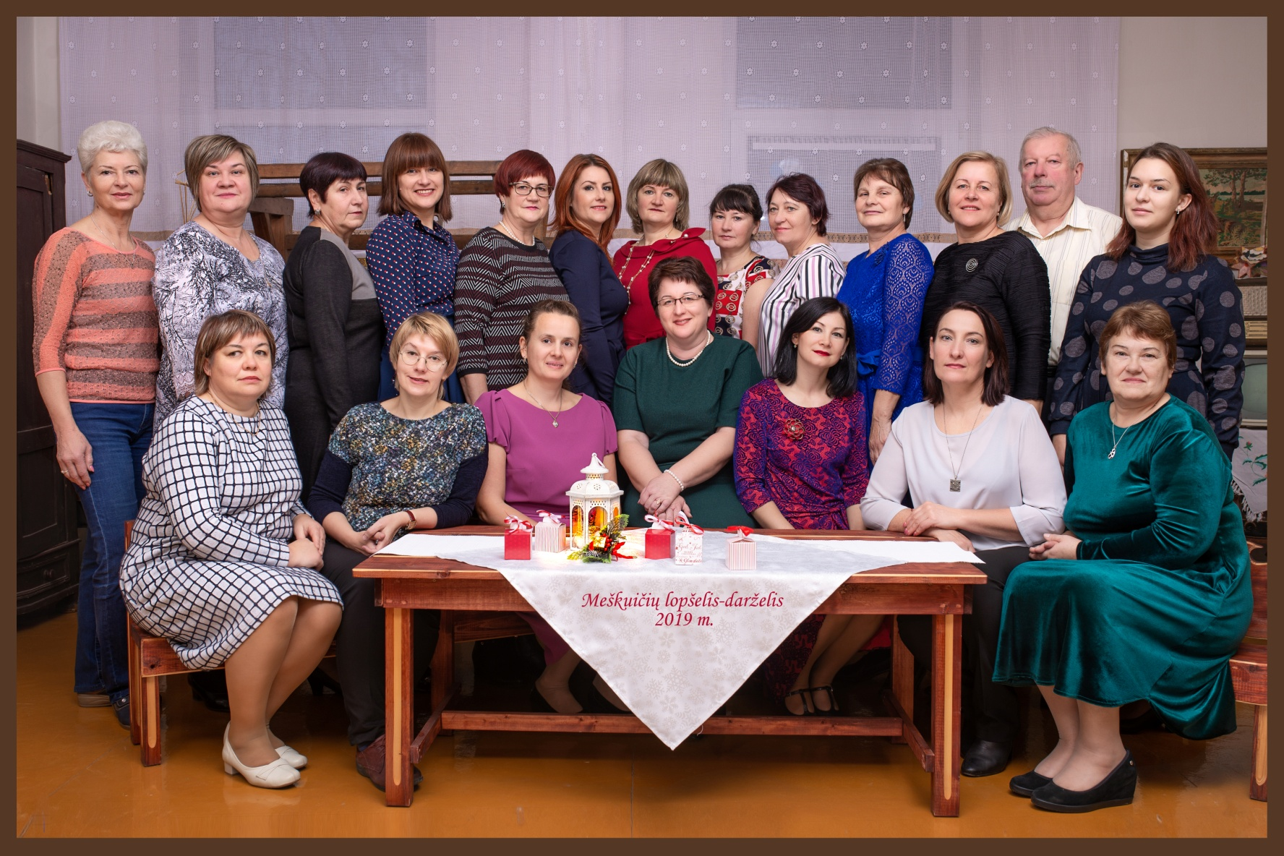
Joyful emotions are provided by entertainment organized by our communities : sports, literary, musical, dance.

Slide 7
The main focus is on sports,

Slide 8
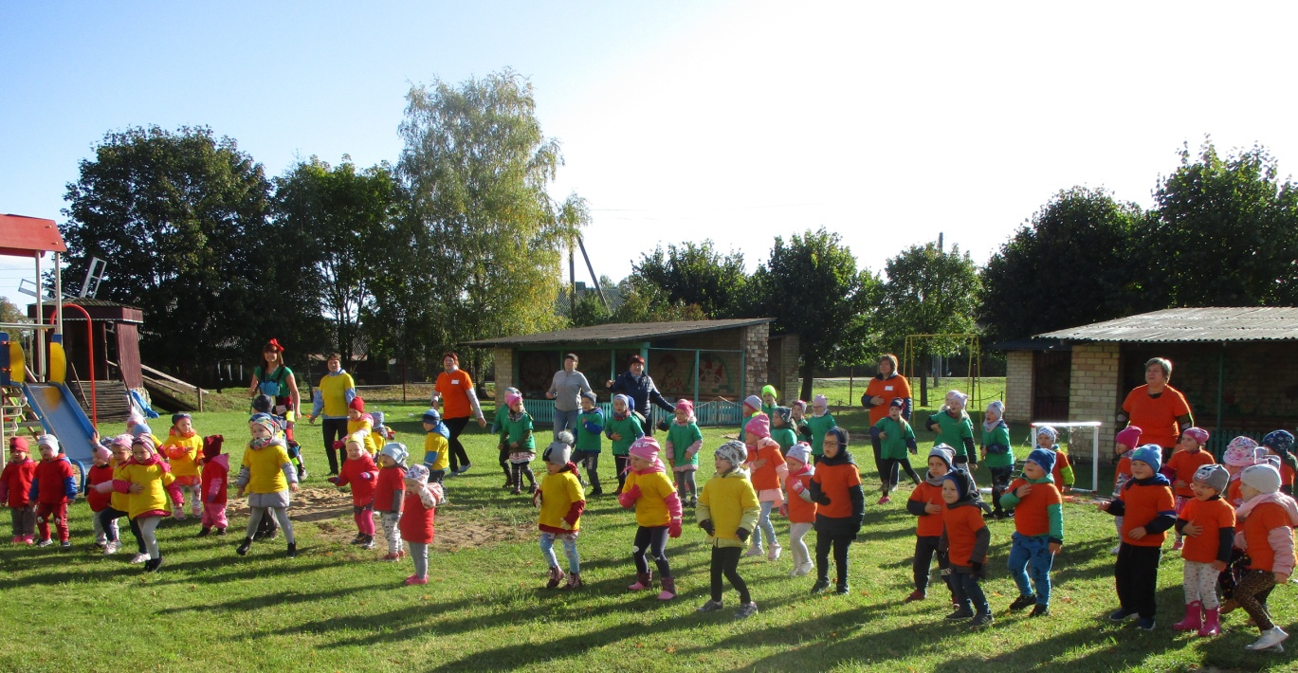
We are participating in the republican project football

Slide 9
and in experiential and health education,
Steam
Health

Slide 10
Favorite activities
“Goat Garden and Greenhouse”

Slide 11
ARTS

Slide 12
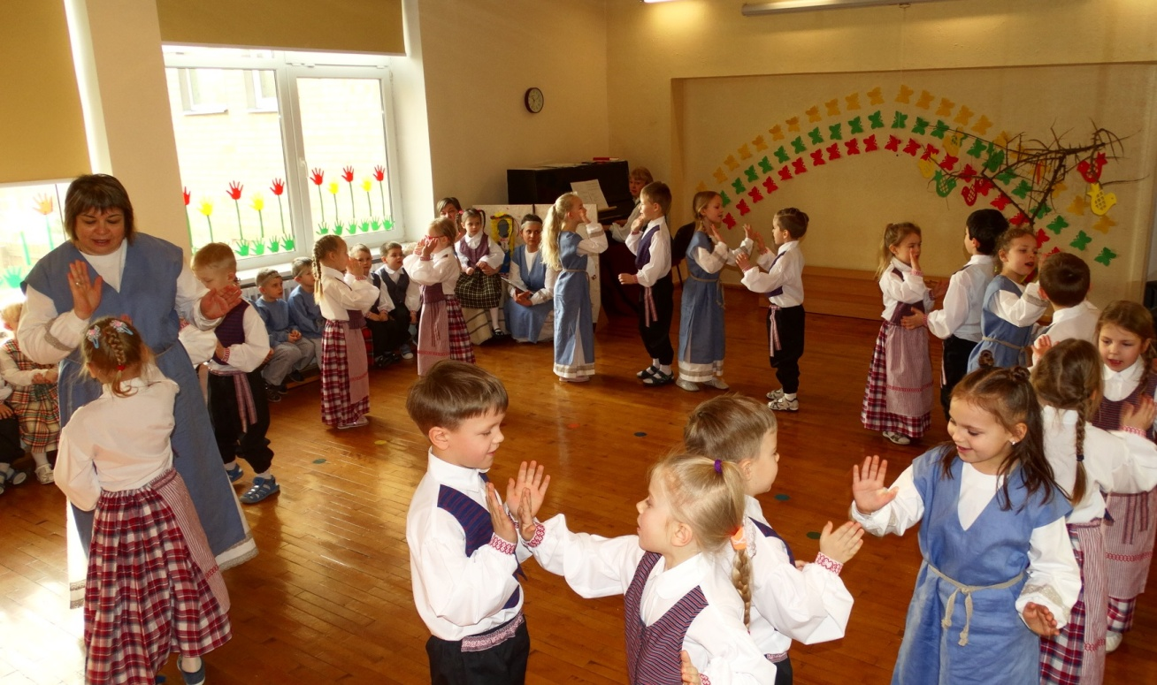
Conditions have been created for children's individual abilities to express themselves: singing, acting, dancing.

Slide 13
The children of the drama studio participate in the events of the district, giving joy the seniors of Meškuičiai town with their performances.

Slide 14
We also like to listen fairy tales, play them and create stories ourselves!

Slide 16
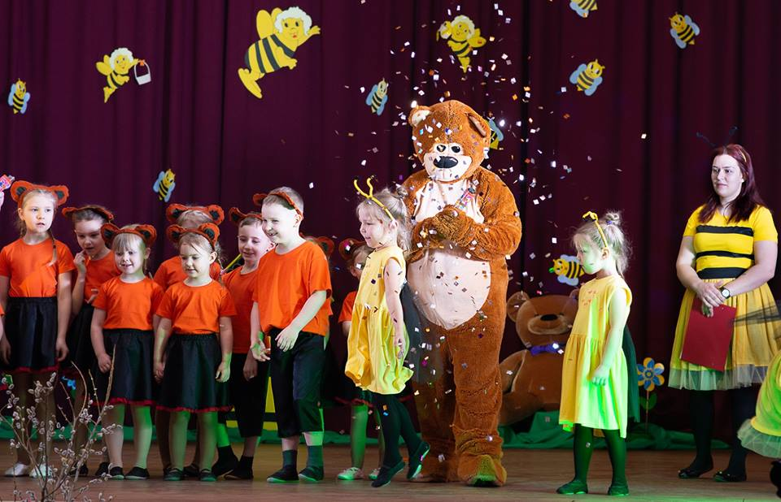
We are happy to participate in the project ,,Story telling is an ART” and welcome all guests !

